Slide 1
Economics 144 Economic Forecasting
Lecture 15
Autoregressive Conditional Heteroscedasticity Models
(ARCH/GARCH)
Dr. Randall R. Rojas

Slide 2
Today’s Class
The ARCH Family
ARCH Models
The ARCH(1) Process
The ARCH(p) Process
GARCH Models
The GARCH(1,1) Process
The GARCH(p,q) Process

Slide 3
The ARCH Family
Def: ARCH(1) = Autoregressive Conditional Heteroscedasticity Process of order 1:
Y_{t} = μ_{t|t-1}+ε_{t}, where μ_{t|t-1} is the conditional mean and ε_{t} is a white noise process s.t:
ε_{t}= σ_{t|t-1}z_{t} and z_{t} ~WN(0,1), where
σ²_{t|t-1}= E[ε²_{t}| I_{t-1}] = ω+α₁ε²_{t-1}
= Conditional variance of ε_{t}
subject to ω>0, α₁ ≥0

Slide 4
ARCH Models
For every ARCH process, we need to address the following 3 questions:
What does a time series of an ARCH process look like?
What do the corresponding ACFs and PACFs look like?
What is the optimal forecast?

Slide 5
ARCH Models Example: ARCH(1) Process
(1) What does a time series of an ARCH(1) process look like?
Consider the following ARCH(1) process:
Y_{t} = μ_{t|t-1}+ε_{t} =μ_{t|t-1}+ σ_{t|t-1}z_{t}, σ²_{t|t-1}= ω+αε²_{t-1}
We can plot this process for μ_{t|t-1} = 2, z_{t} ~N(0,1),
ω = 2, and different values of α, e.g., for α=0.3, α=0.6, α=0.9.
We can show that as α increases, the series becomes more volatile.

Slide 6
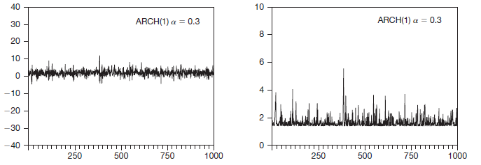
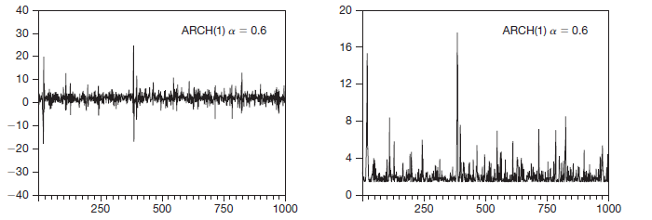
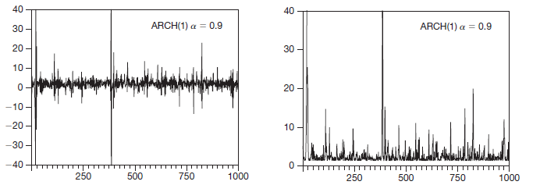
Simulated
ARCH(1) Process
Y_{t} = 2 + ε_{t}
σ²_{t|t-1}= 2 + 0.3ε²_{t-1}
Y_{t} = 2 + ε_{t}
σ²_{t|t-1}= 2 + 0.6ε²_{t-1}
Y_{t} = 2 + ε_{t}
σ²_{t|t-1}= 2 + 0.9ε²_{t-1}
Notes:
What does the heteroskedastic residuals plot look like? Ans: it will start small and branch out

Slide 7
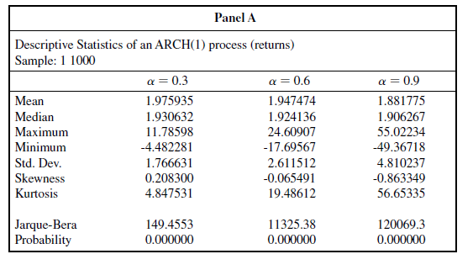
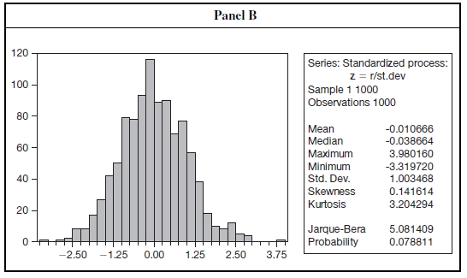
Descriptive Statistics of an ARCH(1) Process and Standardized Process
μ (unconditional) remains
constant ~ 2
σ (unconditional) increases
with increasing α
If this is a true ARCH(1)
process, then we expect
the distribution of the
standardized process to ~N(0,1)
Y_{t} - μ
σ_{t|t-1}
z_{t} =
Fail to reject the
normality hypothesis

Slide 8
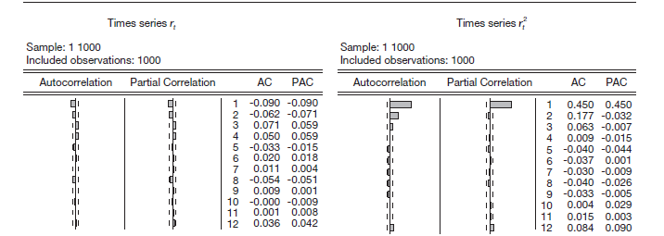
Autocorrelation Functions of Simulated ARCH(1) Processes
Y_{t} = 2 + ε_{t}
σ²_{t|t-1}= 2 + 0.3ε²_{t-1}
Y_{t}
Y²_{t}
The series Y²_{t} is autocorrelated
Dynamics implied by the ARCH(1) Process
The series Y_{t} is uncorrelated
No dynamics in the conditional
mean →ACF and PACF →0
The series Y²_{t} is correlated with
ACF and PACF →AR process
Observe dynamics implied by
the ARCH(1) Process

Slide 9
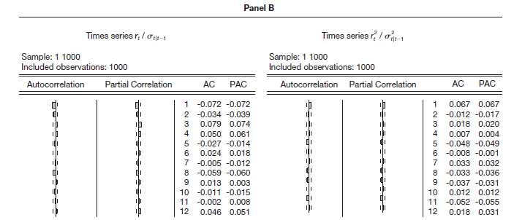
Autocorrelation Functions of Simulated ARCH(1) Processes
Y_{t} = 2 + ε_{t}
σ²_{t|t-1}= 2 + 0.3ε²_{t-1}
Y_{t} /σ_{t|t-1}
Y²_{t} /σ²_{t|t-1}
The series Y²_{t} is autocorrelated
Dynamics implied by the ARCH(1) Process
No more correlations left. Both the ACF and PACF are ‘clean’. Therefore, the ARCH(1) is accurate in capturing the dynamics of the Y_{t} process.
Notes:
ARCH is used when you have taken care most of the dynamics in the data. Then take a square of the residuals and run it with ARCH.

Slide 10
ARCH Models Forecasting in an ARCH(1) Process
Consider first the 1-step-ahead variance forecast,
h = 1,ARCH(1):
σ²_{t+1|t}= ω + αε²_{t}
→h=2: σ²_{t+2|t}= ω + ασ²_{t+1|t}
σ²_{t+h|t}= ω(1+α+α²+•••+α^{h-2}) + α^{h-1}σ²_{t+1|t}
as h→ ∞, σ²_{t+h|t} = ω/(1-α)
•
•
•

Slide 11
ARCH Models
In general, for an ARCH(p) process:
Y_{t} = μ_{t|t-1}+ε_{t} =μ_{t|t-1}+ σ_{t|t-1}z_{t} , where
σ²_{t|t-1}= ω+α₁ε²_{t-1} +α₂ε²_{t-2} +•••+α_{p}ε²_{t-p}
for ω>0, α_{i} ≥0,i=1, 2, …, p.
Note: α₁ + α₂+•••+α_{p} = Persistence in Variance

Slide 12
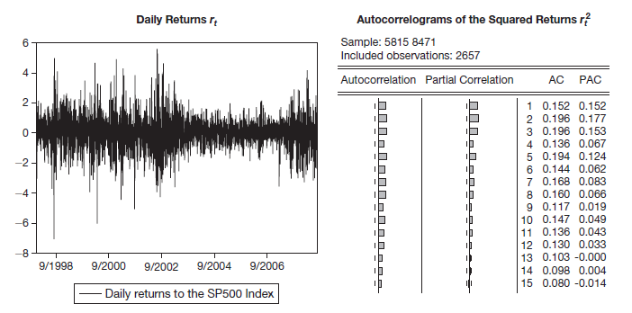
Example: ARCH(p) Process Daily SP500 Returns and Autocorrelations of Squared Returns
Q: What type of a process is this?
Try an ARCH(8) or ARCH(9)
High persistence

Slide 13
GARCH Models Example: GARCH(1,1) Process
(1) What does a time series of a GARCH(1,1) process look like?
Consider the following GARCH(1,1) process:
Y_{t} = μ_{t|t-1}+ε_{t} =μ_{t|t-1}+ σ_{t|t-1}z_{t},
σ²_{t|t-1}= ω+αε²_{t-1}+ βσ²_{t-1|t-2}
where ω>0, α≥0, and β≥0.
Also depends on the most
recent level of volatility
For example, if β=0.7, we interpret this as saying that
70% of yesterday’s variance carries over to today’s variance.
Notes:
It takes into account of clustering volatility since it looks at the previous conditional variance

Slide 14
GARCH Models Example: GARCH(1,1) Process
The key advantage of introducing the term βσ²_{t-1|t-2} is parsimony! → Fewer parameters to estimate than ARCH.
For example, the previous ARCH(9) model for S&P500 returns suggested an ARCH(9) –need 10 estimates- yet we can do the same with a GARCH(1,1) -only need 3 estimates.
A GARCH(1,1) process is equivalent to an ARCH(∞) process with exponentially decreasing weights {α, αβ, αβ²,…}.
The Persistence of the GARCH(1,1) Process is equal to
α + αβ + αβ²+…= α/(1-β).

Slide 15
GARCH Models Example: GARCH(1,1) Process
Y_{t} = 2 + ε_{t} and σ²_{t|t-1}= 2+αε²_{t-1}+ βσ²_{t-1|t-2}
Case 1: Low Persistence process: α=0.4 β=0.4,
→ persistence =α/(1-β) = 0.67
Case 2: High Persistence process: α=0.1, β=0.88, persistence =α/(1-β) = 0.83

Slide 16
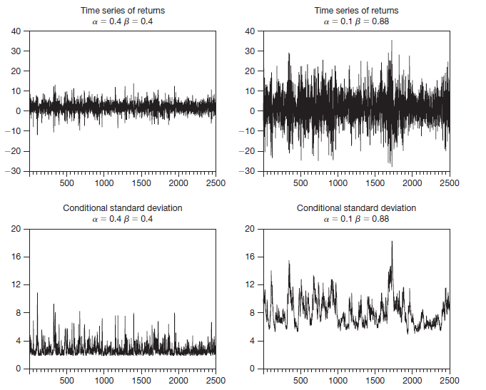
Simulated GARCH(1,1) Process
Low
Persistence
High
Persistence
For a high (low)
persistence process, once the volatility is high, it tends to remain
high (low).
For the low
persistence process,
only 40% of the past
volatility is transferred
to the current volatility.

Slide 17
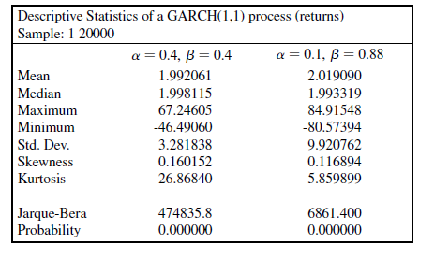
Simulated GARCH(1,1) Process

Slide 18
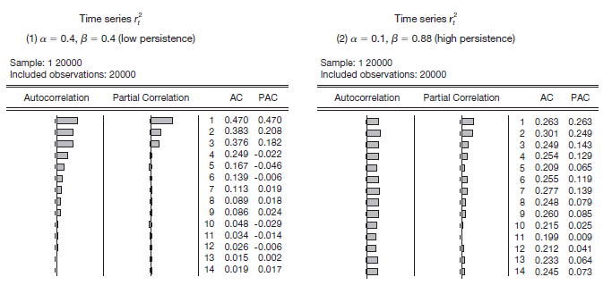
Simulated GARCH(1,1) Process
Y_{t} = 2 + ε_{t} and σ²_{t|t-1}= 2+αε²_{t-1}+ βσ²_{t-1|t-2}
ARCH(3)
ARCH(9)
Low persistence → faster decay High persistence → slower decay

Slide 19
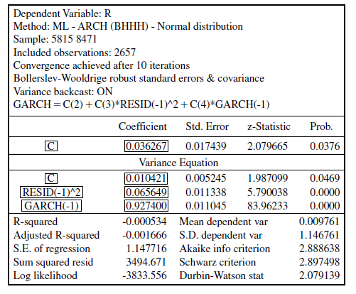
Example: GARCH(1,1) Process Daily SP500 Returns and Autocorrelations of Squared Returns
Q: Was GARCH(1,1) a good model fit?

Slide 20
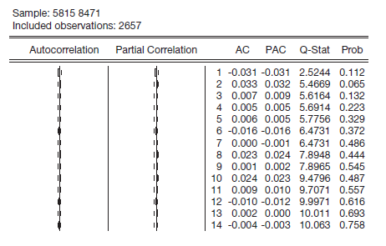
Example: GARCH(1,1) Process Autocorrelation Function of the Standardized Squared Residuals from GARCH(1,1) for S&P500 Daily Returns
A: Yes!

Slide 21
GARCH Models Forecasting in a GARCH(1,1) Process
Consider first the 1-step-ahead variance forecast, h = 1,
GARCH(1,1): σ²_{t+1|t}= ω + αε²_{t} + βσ²_{t|t-1}
→h=2: σ²_{t+2|t}= ω + (α+β)σ²_{t+1|t}
σ²_{t+h|t}= ω(1+ (α+β)+ (α+β)²+•••++ (α+β)^{h-2}) + (α+β)^{h-1}σ²_{t+1|t}
as h→ ∞, σ²_{t+h|t} = ω/(1-(α+β)) = σ²(unconditional variance).
•
•
•

Slide 22
GARCH Models GARCH(p,q)
Y_{t} = ε_{t}
ε_{t}|Ω_{t-1} ~N(0, σ²_{t} )
σ²_{t} = ω+α(L)ε²_{t}+β(L)σ²_{t}
ω>0, Σ α_{i} +Σ β_{i} <1
GARCH(p,q) ≈ ARCH(∞)

Slide 23
For Next Class
Readings about today’s class:
Chapter 14ª & 14^{b}
Review Exercises / Problems:
Chapter 13ª: 1, 2, 3, 4
Readings for next class:
Chapter 12 (Cointegration)

